Slide 1

IT Essentials (CompTIA A+) Ch. 10
Implementing Hard Drives

Slide 2
Overview
In this chapter, you will learn how to:
Explain the partitions available in Windows
Discuss hard drive formatting options
Partition and format hard drives
Maintain and troubleshoot hard drives
Notes:
2
Instructor Tip
When gaining attention and establishing common ground, ask questions of the class such as, “Who here has ever partitioned or formatted a hard drive?” or “Who here has ever had a hard drive crash?”
For a positive statement, tell the class, “In this lesson, we are going to learn how to set up a hard drive, partition and format it, and use tools to maintain and troubleshoot a hard drive.”

Slide 3
Partitioning
Partitioning is the process of electronically subdividing the physical hard drive into units called partitions.
Hard drive must have at least one partition.
Each is typically assigned a drive letter such as C: or D:.
Format the drive after partitioning.
Installs a file system onto the drive
Organizes each partition so it can be used to store files and folders

Slide 4
Hard Drive Partitions
Partitioning methods
Master boot record (MBR)
Older style
Readable by other utilities
Called basic disk
GUID partition table (GPT)
Newer scheme that replaces the MBR
Called basic disk
Windows proprietary dynamic storage partitioning scheme
Called dynamic disk
Notes:
Techs often refer to MBR-partitioned drives as “MBR drives.” The same holds true for GPT-partitioned drives, which many techs refer to as “GPT drives.”

Slide 5
Master Boot Record (MBR)
The first sector of an MBR hard drive contains the master boot record (MBR).
MBR is a small amount of data that contains the partition table.
Describes the number and size of partitions on the disk
MBR partition tables support up to four partitions
Instructions in the MBR use the partition table to determine which partition contains the active operating system.

Slide 6
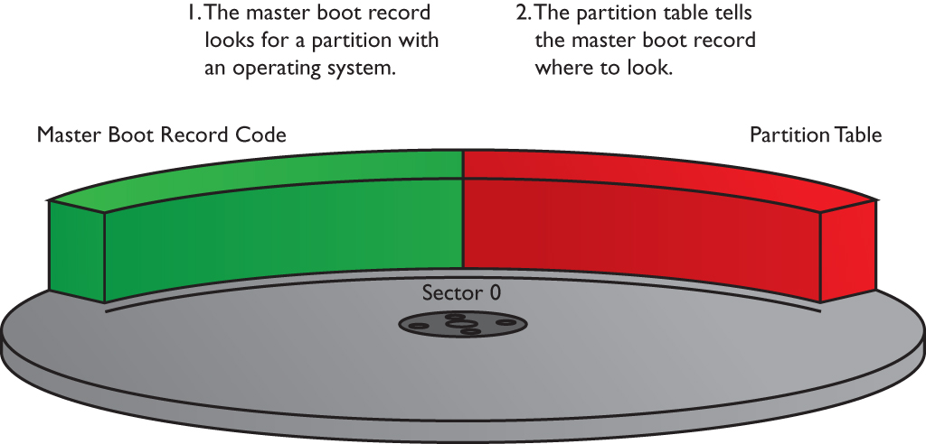
MBR
Figure 10.1 The master boot record

Slide 7
MBR
After the MBR locates the appropriate partition, the partition boot sector loads the OS on that partition.
The partition boot sector stores information important to its partition, such as the location of the OS boot files.

Slide 8
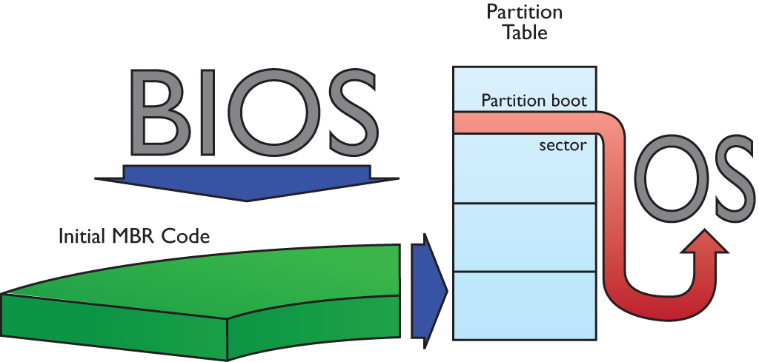
MBR
Figure 10.2 Using the master boot record to boot an OS

Slide 9
MBR
MBR partition tables support primary partitions and extended partitions.
Primary partitions are designed to support bootable operating systems—only one can be active.
Extended partitions are not bootable.
A single MBR disk may have up to four primary partitions or three primary partitions and one extended partition.

Slide 10
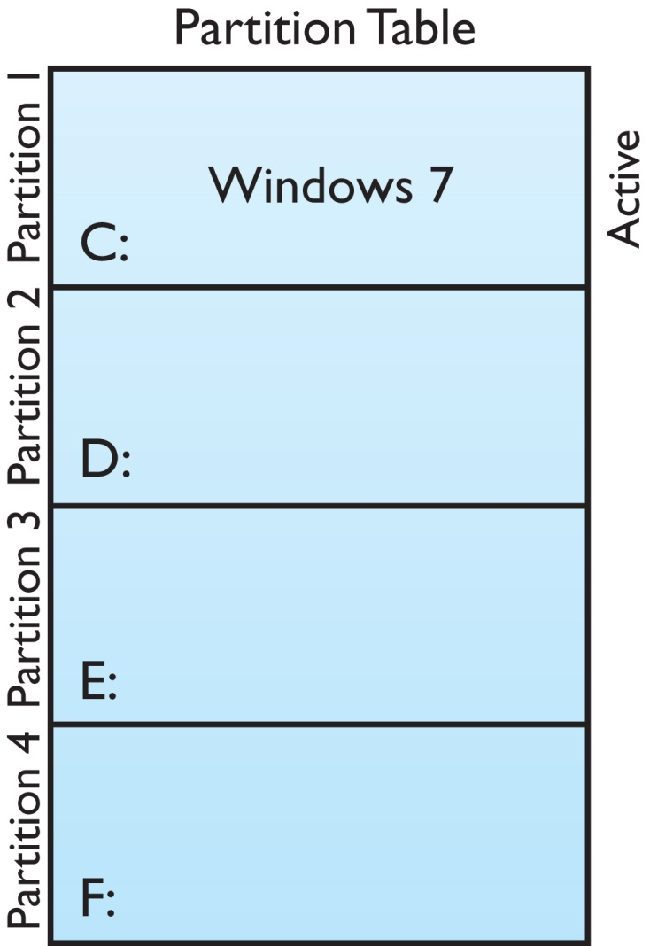
MBR
Figure 10.3 The active partition containing Windows

Slide 11
MBR
Every primary partition on a single drive has a special setting stored in the partition table called active that determines the active partition.
The MBR finds the active partition and boots the operating system on that partition.
Only one partition can be active at a time because you can run only one OS at a time.
Notes:
Exam Tip: Extended partitions do not receive drive letters, but the logical drives within an extended partition do.

Slide 12
MBR
To control multiboot setups, a bootloader can be used.
When the computer boots, the boot-manager software yanks control from the MBR and asks which OS you wish to boot.
Once a partition is set as active, the partition boot sector loads the operating system.
Grand Unified Bootloader (GRUB) is a popular free Linux-based boot manager.

Slide 13
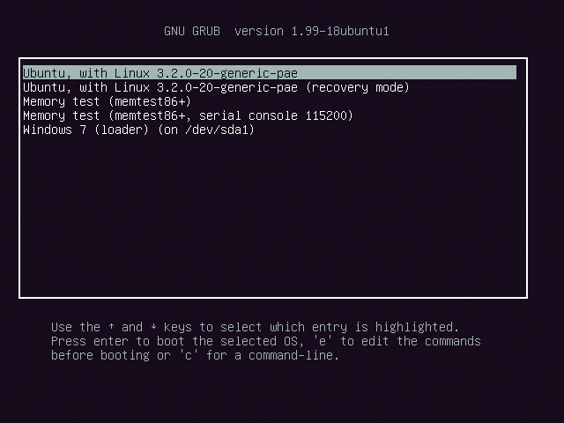
MBR
Figure 10.4 GRUB in action

Slide 14
MBR
With a four-partition limit, an MBR disk is limited to four drive letters if using only primary partitions—an extended partition overcomes this limit.
An extended partition can contain multiple logical drives, each of which can get a drive letter.
A logical drive works like a primary partition, except that you cannot boot from it.

Slide 15
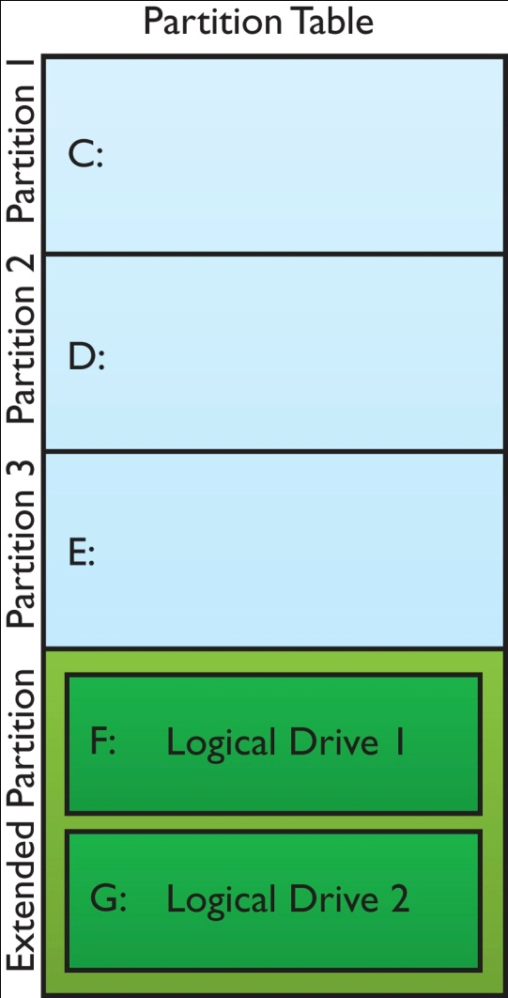
MBR
Figure 10.5 An extended partition containing multiple logical drives

Slide 16
Dynamic Disks
Introduced with Windows 2000
Partitions referred to as volumes
Enable spanned volumes over multiple drives
Enable use of software-based RAID
The RAID levels you can use depends on the version of Windows
Not limited to four volumes

Slide 17
Dynamic Disks
Table 10.1 |  | Dynamic Disk Compatibility
Volume | Windows Vista Business/ Ultimate/Enterprise |  | Windows 7 Professional/ Ultimate/Enterprise | Windows 8/8.1/10 | Window Server
Simple | X |  | X | X | X
Spanned | X |  | X | X | X
Striped | X |  | X | X | X
Mirrored |  |  | X | X | X
RAID 5 |  |  |  |  | X
Notes:
Exam Tip: Only the lower-end editions of Windows Vista and Windows 7 don’t support dynamic disks. Almost every version and edition you’ll run into these days supports dynamic disks.

Slide 18
GUID Partition Table
The globally unique identifier partition table (GPT) follows some of the same principles as the MBR scheme, but many limits have been overcome.
A GPT drive can have an almost unlimited number of primary partitions (Microsoft limits Windows to 128 partitions).
MBR partitions have a limit of 2.2 TB—but GPT is only limited to a size in zettabytes.
Notes:
1 zettabyte = 1 million terabytes

Slide 19
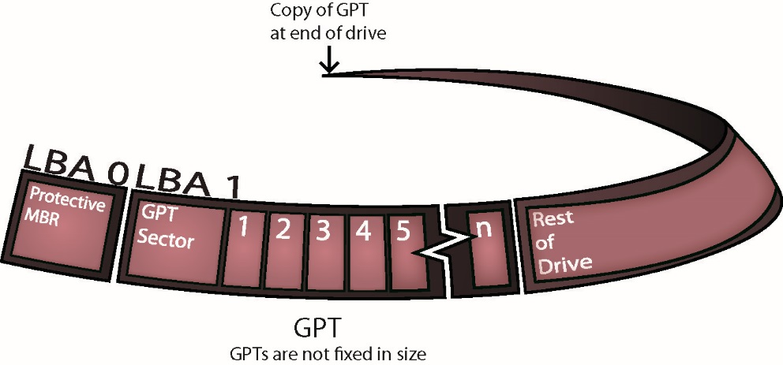
GUID Partition Table
GPT is arranged by LBA instead of sectors.
LBA 0 is the protective MBR.
Figure 10.6 GUID partition table

Slide 20
Other Partition Types
Hidden partition
A primary partition that is hidden from the OS, often used for backup purposes—sometimes called a factory recovery partition
Swap partition
Only found on Linux and UNIX systems
Acts like RAM when system needs more RAM than you have installed
Similar to a Windows page file, but has a dedicated partition

Slide 21
When to Partition
You can partition:
When installing a new OS
When adding a new hard drive
Older Versions of Windows used the FDISK program.
Modern versions use Disk Management.
Linux uses FDISK (not the same as Windows) or other tools, like Gparted.
Current versions of Windows can nondestructively resize partitions.

Slide 22
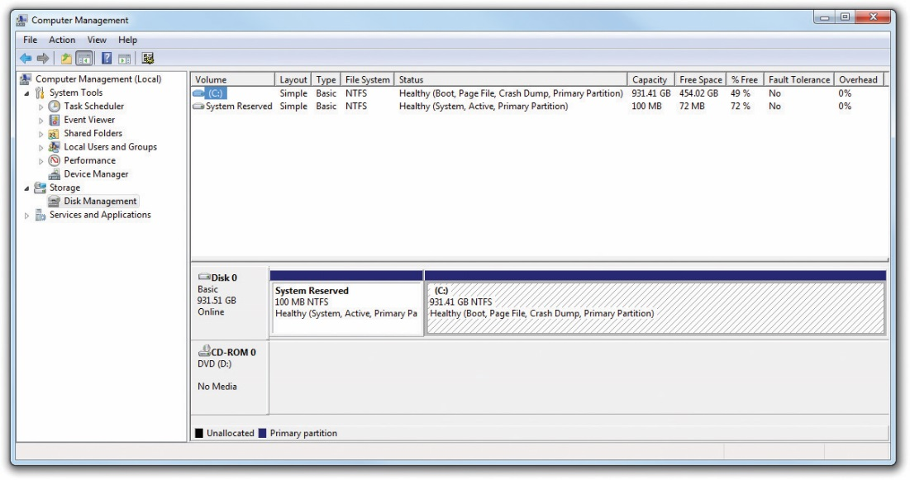
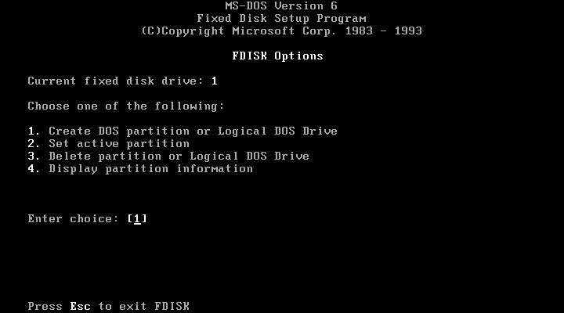
When to Partition
Figure 10.7 FDISK
Figure 10.8 Windows 7 Disk Management tool in Computer Management

Slide 23
Partition Naming Problems
MBR and GPT disks use partitions and dynamic disks use volumes.
Unfortunately, when you create a new partition or volume in current versions of Windows, the tool (Disk Management) only shows that you’re about to create a volume.
Even though the context menu says “volumes,” you create partitions on basic disks.

Slide 24
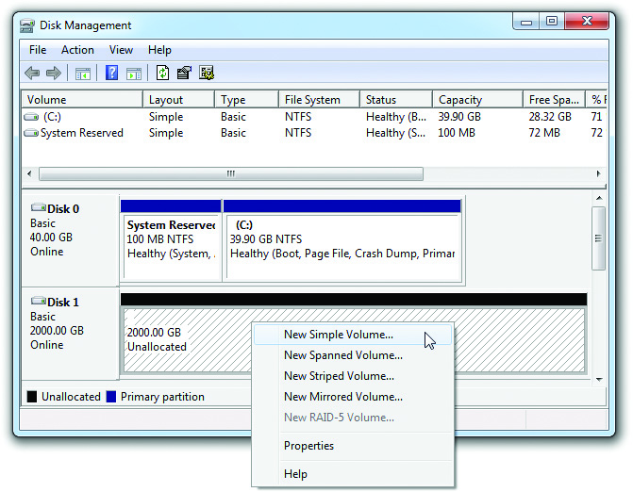
Partition Naming Problems
Figure 10.9 Note that the context menu only mentions volumes, not partitions.

Slide 25
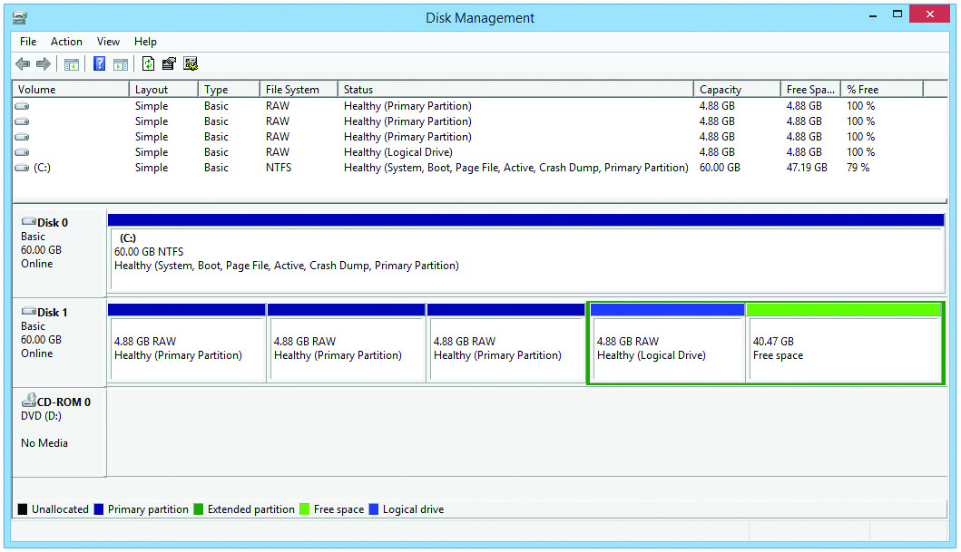
Partition Naming Problems
Figure 10.10 Drive with four partitions displayed in Disk Management

Slide 26
Hard Drive Formatting
Formatting configures a partition to hold files and folders suitable to the OS.
Two major functions of formatting:
Creates a file system
Creates a root directory

Slide 27
File Systems in Windows
Windows supports four different file systems:
FAT (often called FAT16)
FAT32
NTFS
exFAT/FAT64 (for removable media)

Slide 28
File Allocation Table (FAT)
Sector
Base area of storage for hard drives
Stores up to 512 bytes of data
File allocation table
Indexing system to keep track of data on a hard drive
Determines which sectors store various parts of a file
Also called data structure

Slide 29
FAT
16-bit FAT (FAT16) uses 4 hexadecimal digits to number the sectors.
0000 thru FFFF
FAT is like a two-column spreadsheet.
Column one numbers the sectors.
Column two contains the status of the sector.
Bad sectors = FFF7
Good sectors = 0000
Full format creates the FAT and then writes to and reads from each sector to see if it is good.

Slide 30
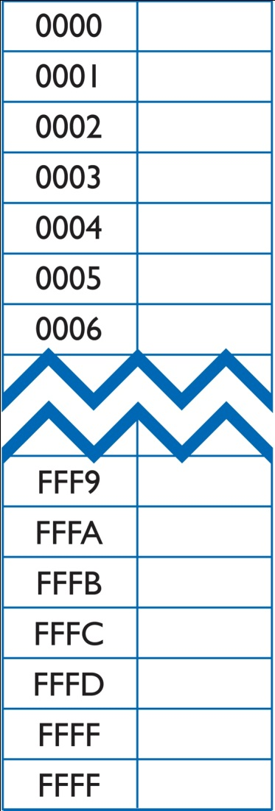
FAT
Figure 10.11 16-bit FAT
Notes:
Hexadecimal characters cover the decimal numbers 0-15; and number 0-9, A-F; each character reflects the state of four binary characters. You add them up to make the number. So, 0000 in binary shows zero numbers and the hex number is 0. When you go up numerically in binary to 0001, this represents the number 1 in decimal and also in hex. The key to hex is when you reach the number 10. In binary, this looks like this: 1010. But because hex sticks with a single digit, it’s represented as A. B translates as 11 in decimal or 1011 in binary, and so on.

Slide 31
FAT Limitations
16 bits – only 64 K (2¹⁶) sectors addressed
Sector sizes limited to 512 bytes
64 K × 512 bytes = 32 MB maximum size in early drives
What to do to increase capacity?
Clustering as the solution
Enables partition sizes up to 2 GB

Slide 32
Clustering
Clustering combines a set of contiguous sectors and treats them as a single unit.
Units are called clusters or file allocation units.
Instead of numbering the sectors, clusters were numbered.
This allowed partition sizes up to 2 GB.
Size of cluster increases with the size of the partition.

Slide 33
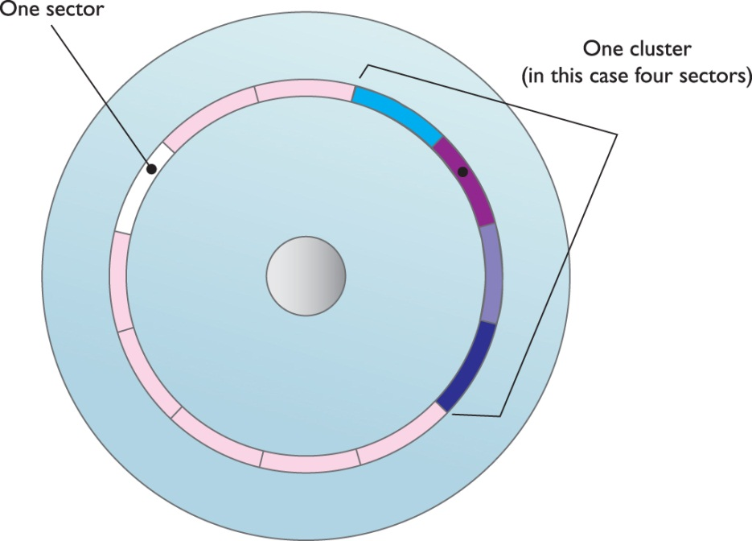
Clustering
Figure 10.12 Cluster versus sector
Notes:
33

Slide 34
Clustering
Table 10.2 | FAT16 Cluster Sizes
If FDISK makes a partition this big: |  | You’ll get this many sectors/cluster:
16 to 127.9 MB |  | 4
128 to 255.9 MB |  | 8
256 to 511.9 MB |  | 16
512 to 1023.9 MB |  | 32
1024 to 2048 MB |  | 64

Slide 35
FAT16 in Action
Windows looks for the first cluster marked 0000 (good and available).
If the file fits in that cluster, FFFF is put in the status column.
If the file is larger than the cluster, Windows finds the next open cluster.
That open cluster’s number is put in the first status field to know where to link.
Process continues until the file is fully stored.
Last cluster’s status field is FFFF (end-of-file).

Slide 36
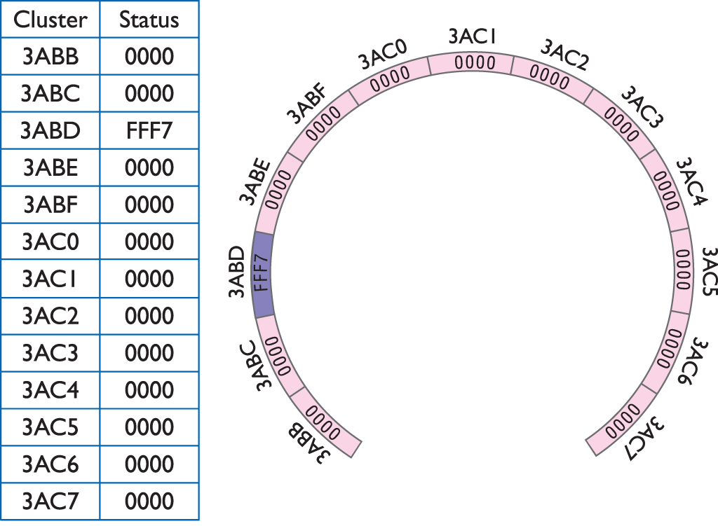
FAT16 in Action
Figure 10.13 The initial FAT
Notes:
36

Slide 37
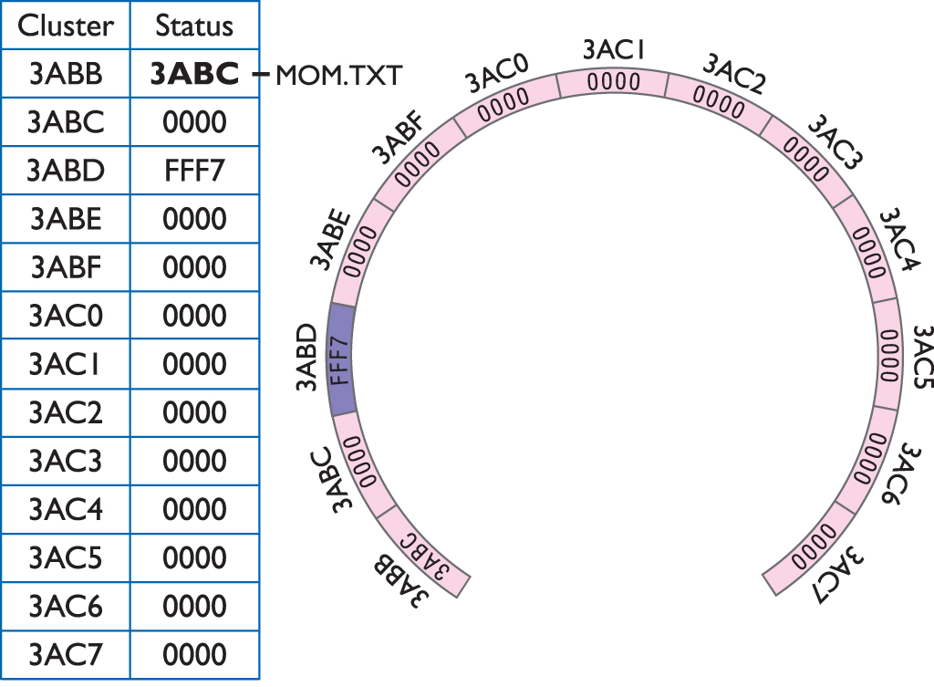
FAT16 in Action
Figure 10.14 The first cluster used
Notes:
37

Slide 38
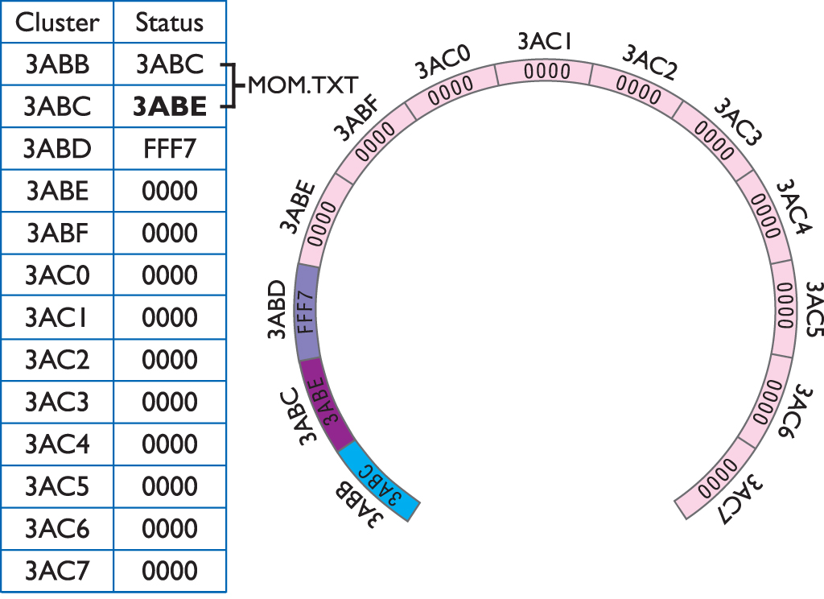
FAT16 in Action
Figure 10.15 The second cluster used
Notes:
38

Slide 39
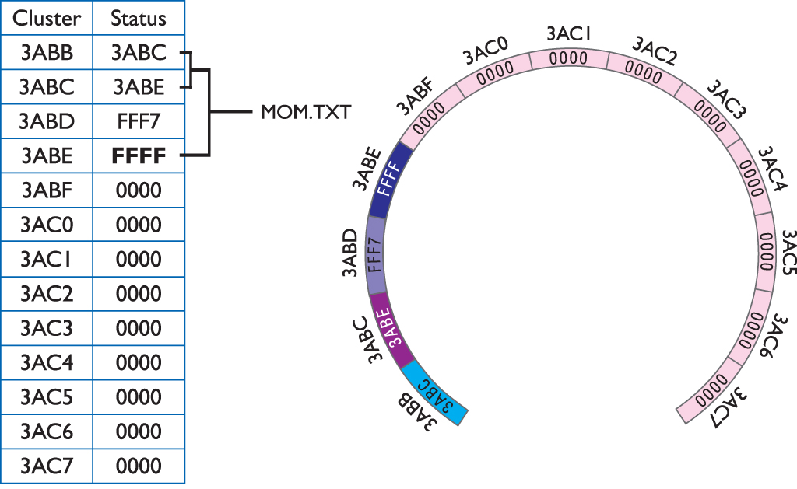
FAT16 in Action
Figure 10.16 End of file reached

Slide 40
Fragmentation
Fragmentation occurs when files are spread across clusters.
Individual files are broken into pieces that fit into a sector or cluster.
The pieces are stored on the hard drive but may not be stored in contiguous clusters.
Fragmentation slows down the system during hard drive reads and writes.
Programs such as Disk Defragmenter and Optimize Drives can rearrange files.

Slide 41
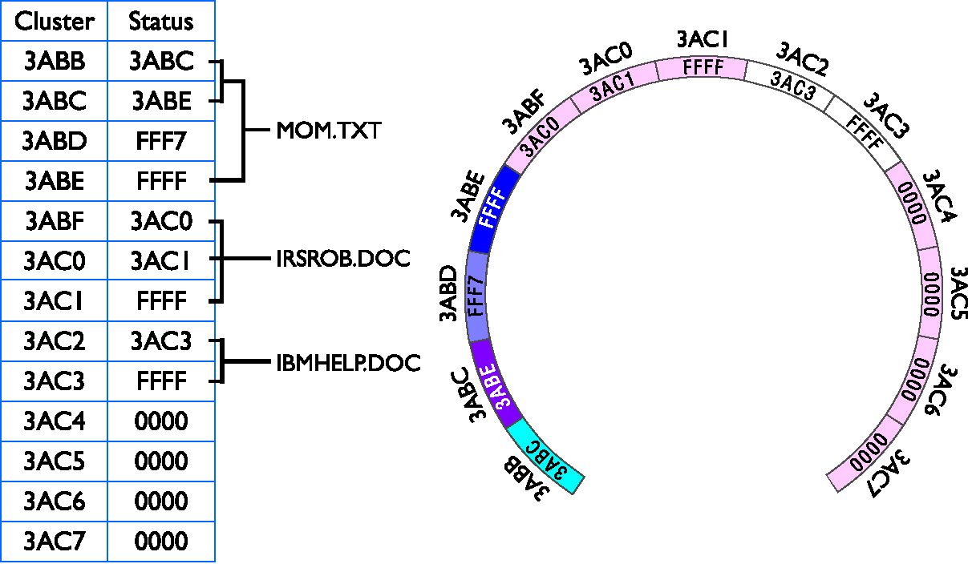
Fragmentation
Figure 10.17 Three files saved

Slide 42
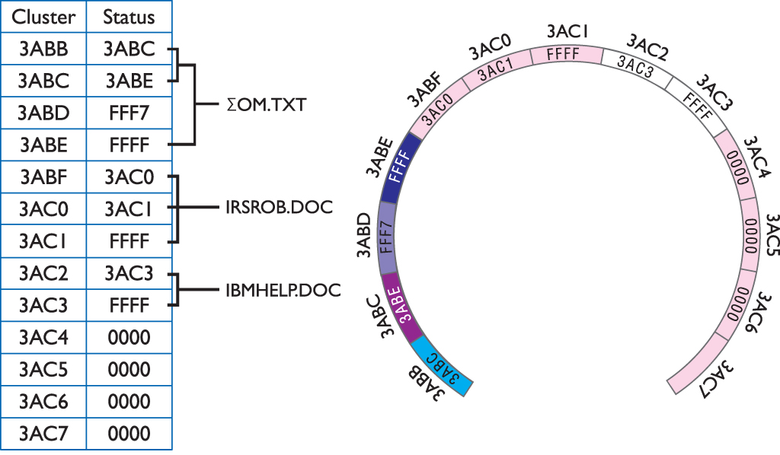
Fragmentation
Figure 10.18 The mom.txt file erased
Notes:
42

Slide 43
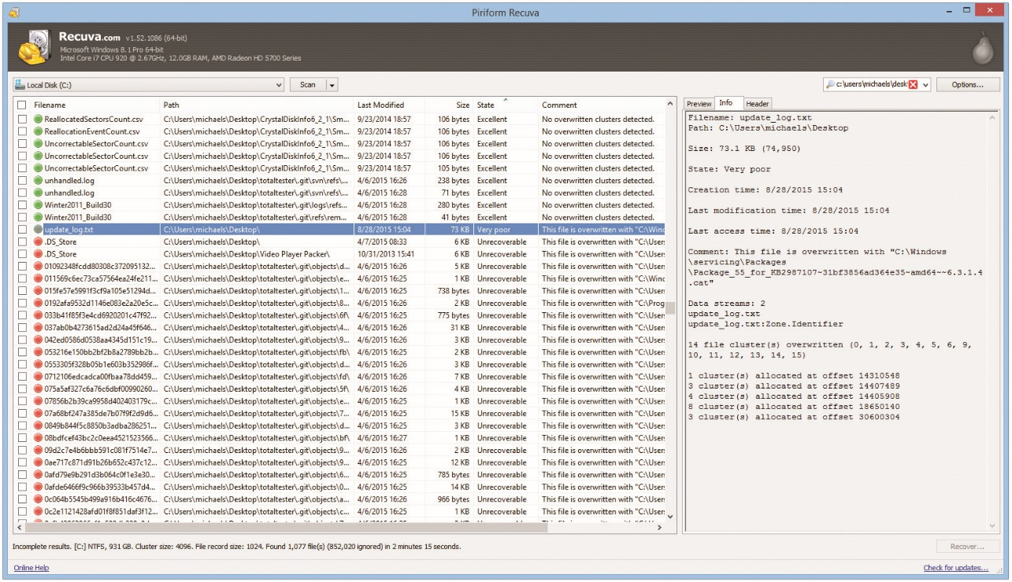
Fragmentation
Figure 10.19 Piriform Recuva in action
Notes:
43

Slide 44
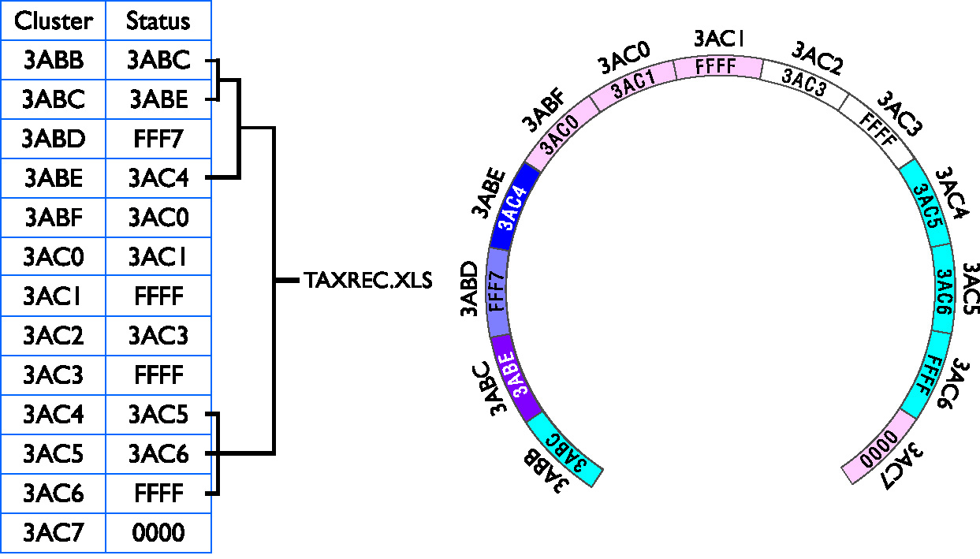
Fragmentation
Figure 10.20 The taxrec.xls file fragmented
Notes:
44

Slide 45
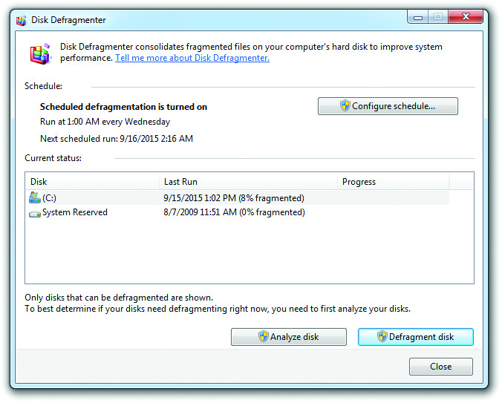
Fragmentation
Figure 10.21 Windows 7 Disk Defragmenter
Notes:
45

Slide 46
FAT32
FAT32 introduced with Windows 95 OSR2 (OEM Service Release 2)
Supports partitions up to 2 terabytes
Uses 32 bits to describe each cluster
Allows the use of small clusters
Can still become fragmented
Commonly used on smaller USB flash drives

Slide 47
FAT32
Table 10.3 | FAT32 Cluster Sizes
Drive Size |  | Cluster Size
512 MB or 1023 MB |  | 4 KB
1024 MB to 2 GB |  | 4 KB
2 GB to 8 GB |  | 4 KB
8 GB to 16 GB |  | 8 KB
16 GB to 32 GB |  | 16 KB
>32 GB |  | 32 KB

Slide 48
New Technology File System
NTFS was introduced with Windows NT.
The file system of choice today
Major improvements/refinements include:
Redundancy
Security
Compression
Encryption
Disk quotes
Cluster sizing

Slide 49
NTFS Structure
NTFS structure provides redundancy.
Uses an enhanced file allocation table called the master file table (MFT)
NTFS keeps a backup copy in the middle of the disk.
Security is provided for objects.
Provides file and folder access control
Uses Access Control List (ACL) to restrict or grant access

Slide 50
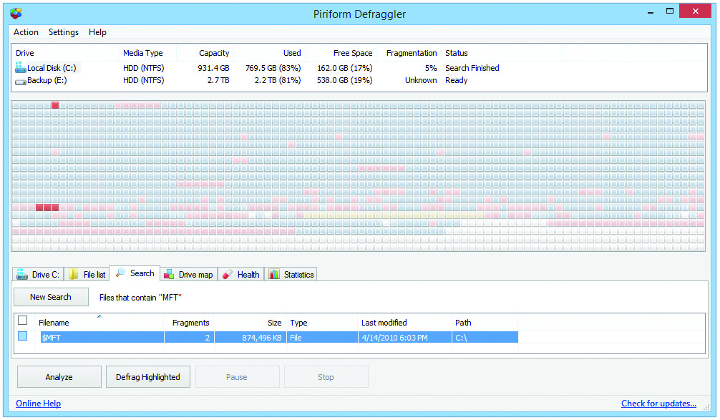
NTFS Structure
Figure 10.22 The NTFS MFT appears in a defragmenter program as the highlighted red blocks.

Slide 51
NTFS Structure
Compression
Files and folders may be compressed to save space.
Windows Explorer/File Explorer displays filenames for compressed files in blue.
Encrypting file system (EFS)
Encrypted files and folders are unreadable to anyone without the key.
Files and folders can be encrypted or compressed.

Slide 52
NTFS Structure
Disk quotas
Can control how users can use space
Set on a per-drive basis
Cluster sizes
It is possible to adjust cluster sizes, but rare to do so.
NTFS supports 16 TB on a dynamic disk but limited to 2 TB on a basic disk.

Slide 53
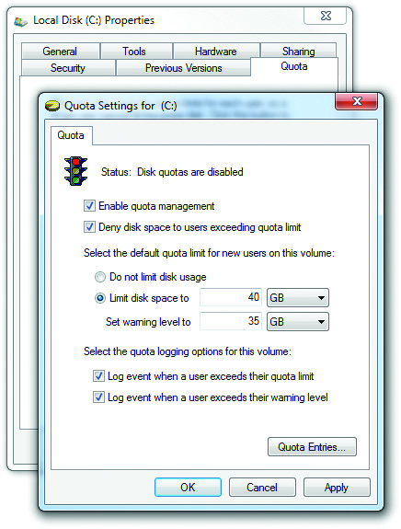
NTFS Structure
Figure 10.23 Hard drive quotas in Windows 7
Notes:
53
Theoretical maximum partition size for NTFS is 16 EB minus 1 KB.

Slide 54
NTFS Structure
Table 10.3 | NTFS Cluster Sizes
Drive Size |  | Cluster Size | Number of Sectors
512 MB or less |  | 512 bytes | 1
513 MB to 1024 MB (1 GB) |  | 1024 bytes (1 KB) | 2
1025 MB to 2048 MB (2 GB) |  | 2048 bytes (2 KB) | 4
2049 MB and larger |  | 4096 bytes (4 KB) | 8

Slide 55
FAT64
Today’s USB drives are considerably larger, so the file system becomes an issue.
FAT32 does not work on drives larger than 2 TB and limits file size to 4 GB.
exFAT (or FAT64) replaced FAT32.
Supports files up to 16 exabytes (EB)
Theoretical partition limit of 64 zettabytes (ZB)
Extends FAT32 from 32-bit cluster entries to 64-bit cluster entries in the file table
Does not have NTFS features (compression, encryption, etc.)

Slide 56
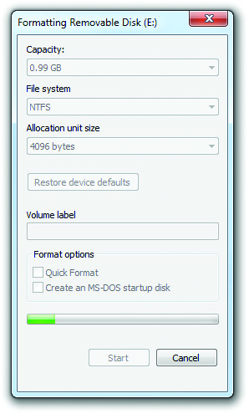
FAT64
Figure 10.24 Formatting a flash drive in Windows
Notes:
56
If for some reason you really want to format large USB flash drives with NTFS, Windows will gladly allow you to do so, as shown in Figure 10.24.

Slide 57
File Systems in Mac OS X
Mac OS X uses the Hierarchical File System Plus (HFS+) by default.
You can read and write to several different file systems with the OS.
Latest versions can read and write to FAT32 and exFAT, though only read NTFS.
Surprisingly, HFS+ is not listed in the CompTIA A+ 902 exam objectives.

Slide 58
File Systems in Linux
Fourth Extended File System (ext4) is used in some Linux distros.
The ext4 file system supports volumes up to 1 exabyte (EB) with file sizes up to 16 TB.
It is backward compatible with predecessors ext2 and ext3.
Linux file system capabilities exceed those of Mac OS X.
Able to read and write to NTFS, FAT32, exFAT, HFS+, ext2, ext3, and ext4

Slide 59
Partitioning and Formatting
Bootable media
Any removable media that has a bootable OS installed
Optical disk or USB flash drive
All Windows and Linux installation CDs
Media that has an image of an installation disk

Slide 60
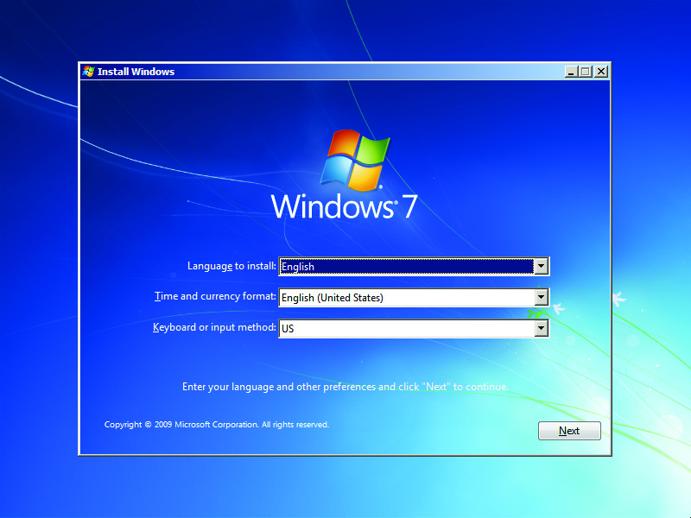
Partitioning and Formatting
Installation screens
Prompts you through sequence of steps to partition and format the hard drive
Figure 10.25 Starting the Windows 7 installation

Slide 61
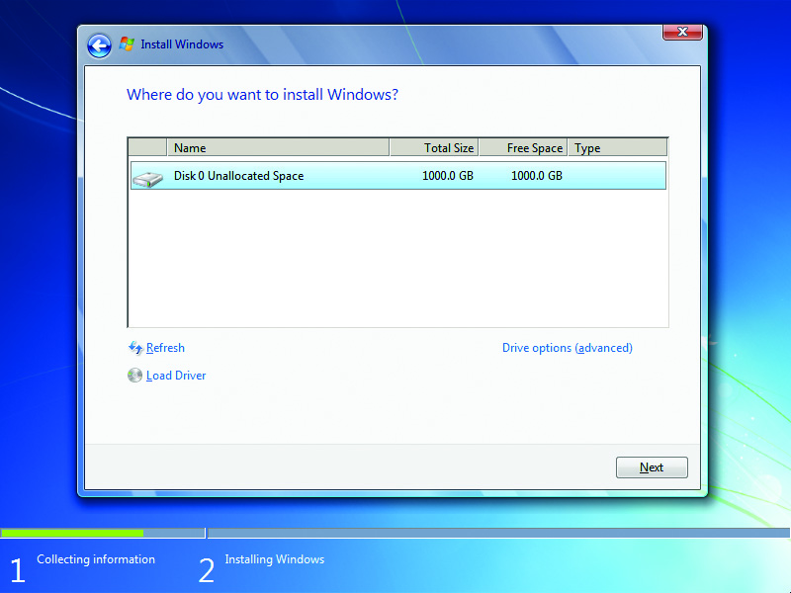
Partitioning and Formatting
Figure 10.26 Where do you want to install Windows?

Slide 62
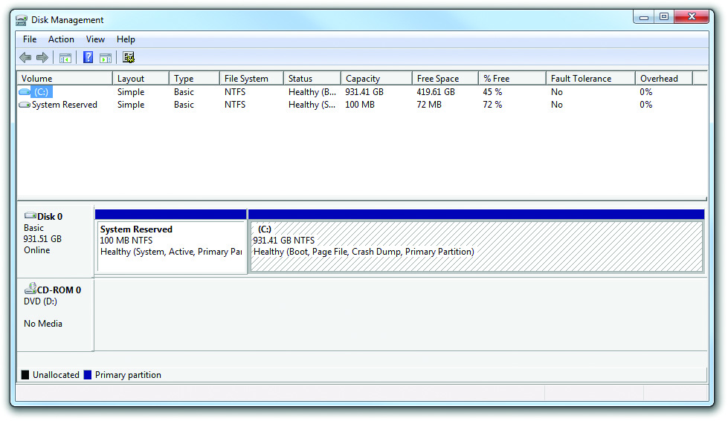
Partitioning and Formatting
Figure 10.27 Disk Management showing the default partitions in Windows 7

Slide 63
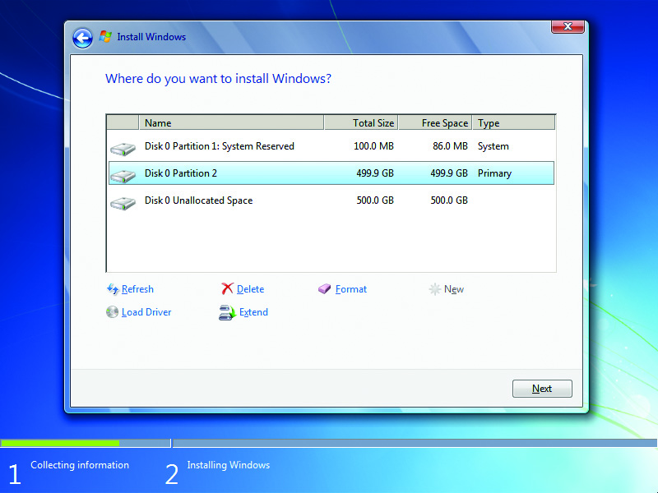
Partitioning and Formatting
Figure 10.28 New 499-GB partition with 100-MB System Reserved partition and Unallocated Space

Slide 64
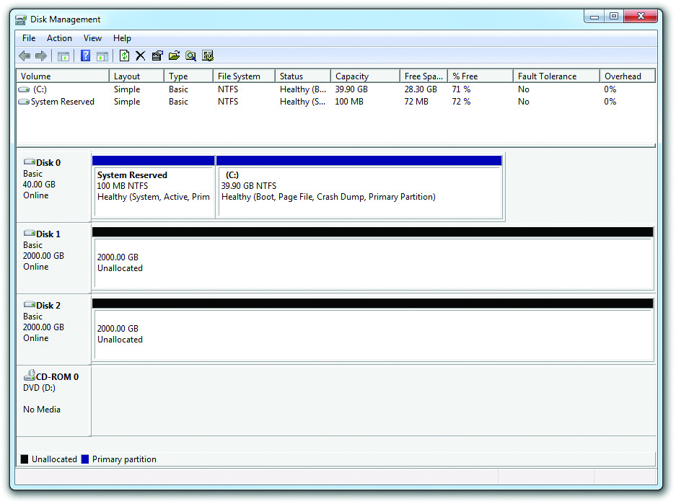
Disk Management
Primary tool for partitioning and formatting drives after installation
Figure 10.29 Disk Management

Slide 65
Disk Initialization
In a Windows system, this process places special information on a hard drive.
Identifies the hard drive and what the hard drive does in the system, e.g., RAID information
All drives must be initialized before you can use them.
To initialize a disk, right-click the icon and select Initialize.
You will get the option to select MBR or GPT as a partition style.

Slide 66
Disk Initialization
You can view the status of a drive in Disk Management.
Healthy: just what it sounds like
Unallocated: space with no partition
Active: potentially bootable partition
Foreign drive: unknown dynamic disk
Formatting: drive is being formatted
Failed: disk is damaged or corrupt
Online: normal, working drive
Offline: corrupted drive, communication problem

Slide 67
Partitions and Volumes
To create partitions or volumes:
Right-click the unallocated part of the drive and select New Simple Volume.
Specify a volume size and click Next.
Assign a drive letter.
The first three volumes created are primary partitions.
Subsequent volumes are logical drives in an extended partition.

Slide 68
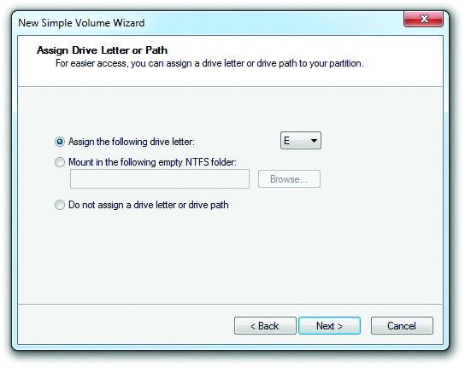
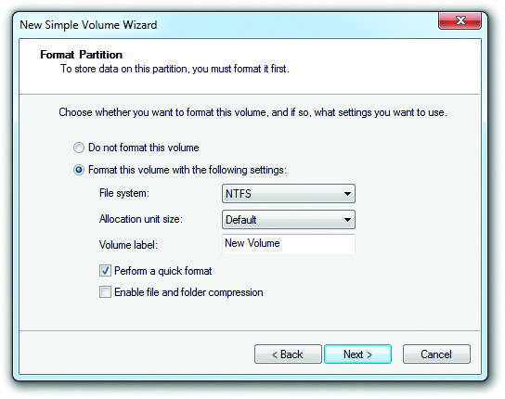
Partitions and Volumes
Figure 10.32 Assigning a drive letter to a volume
Figure 10.33 Choosing a file system type

Slide 69
Partitions and Volumes
Select the type of format for the partition.
If the partition is less than 4 GB, you can choose FAT, FAT32, or NTFS.
If the partition is 4 GB to 32 GB, you can choose FAT32 or NTFS.
If the partition is larger than 32 GB, you can choose only NTFS.
While FAT32 supports partitions up to 2 TB, Microsoft wants you to use NTFS on larger partitions.
Full format tests the disk clusters.
Quick format does not perform tests.

Slide 70
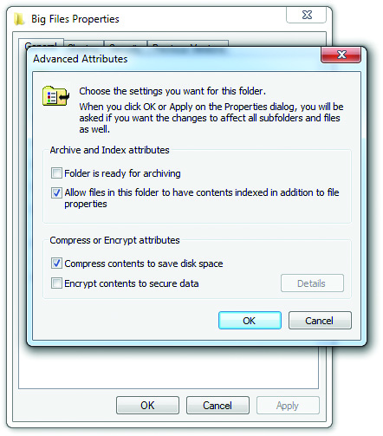
Partitions and Volumes
Figure 10.34 Turning on compression

Slide 71
Dynamic Disks
Create dynamic disks from basic disks in Disk Management.
Types of volumes include:
A simple volume, which acts just like a primary partition.
A spanned volume, which extends a partition on a single drive into unallocated space or extends the volume to grab extra space on completely different dynamic disks.

Slide 72
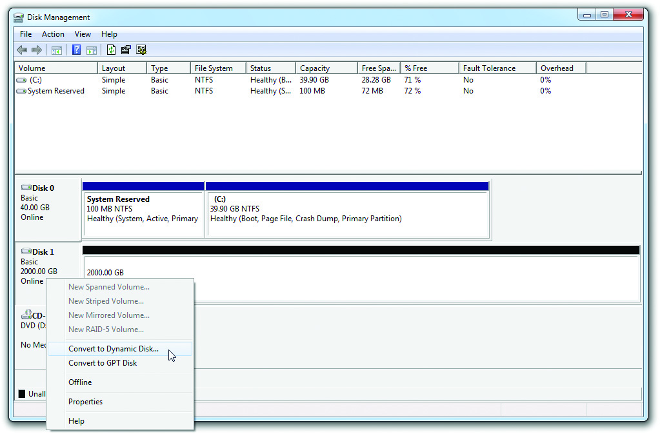
Dynamic Disks
Figure 10.35 Converting to a dynamic disk

Slide 73
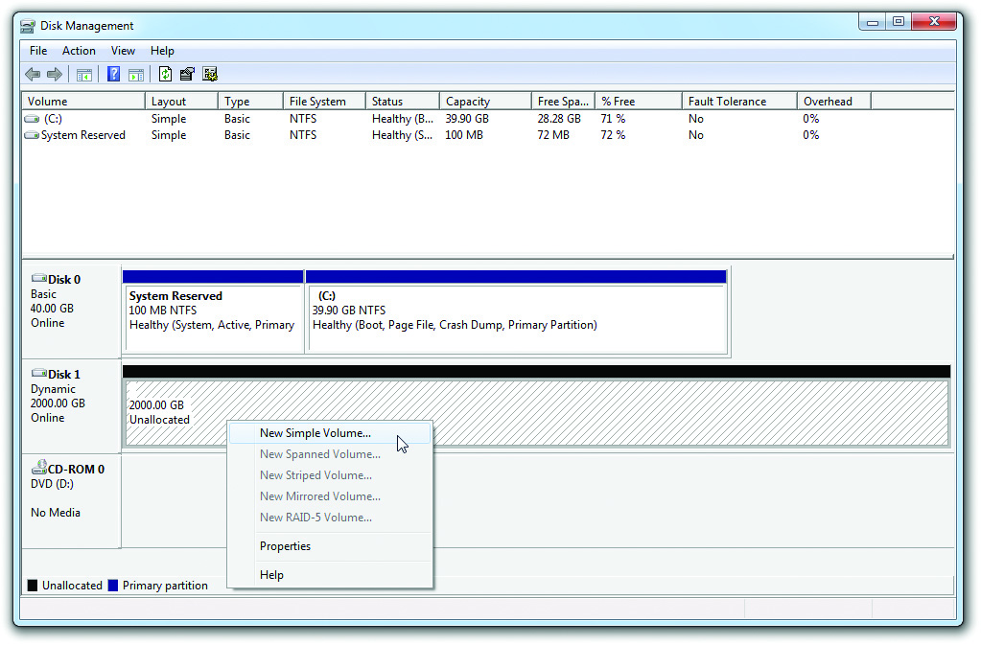
Dynamic Disks
Figure 10.36 Selecting to open the New Simple Volume Wizard

Slide 74
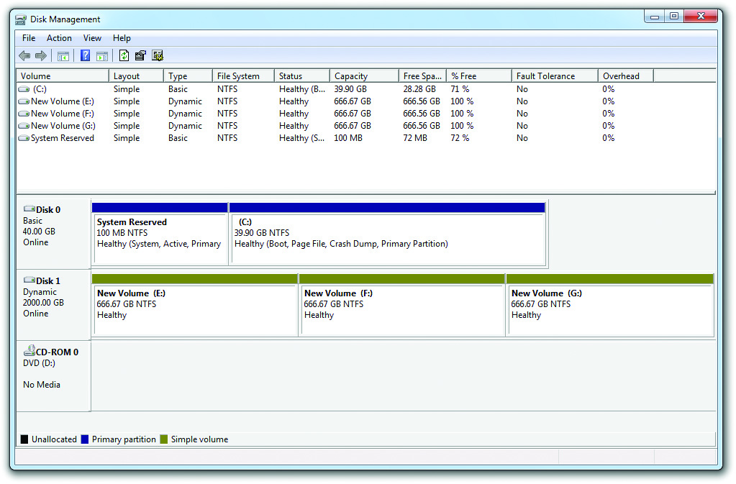
Dynamic Disks
Figure 10.37 Simple volumes

Slide 75
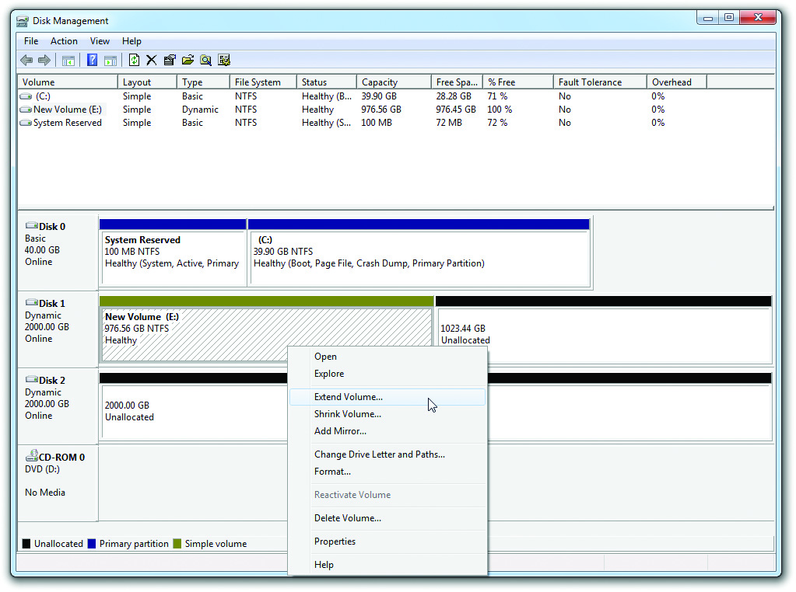
Dynamic Disks
Figure 10.38 Selecting the Extend Volume option

Slide 76
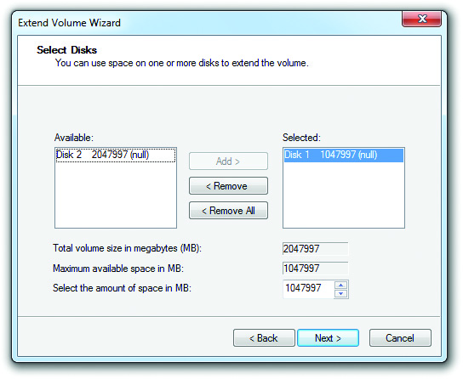
Dynamic Disks
Figure 10.39 The Extend Volume Wizard

Slide 77
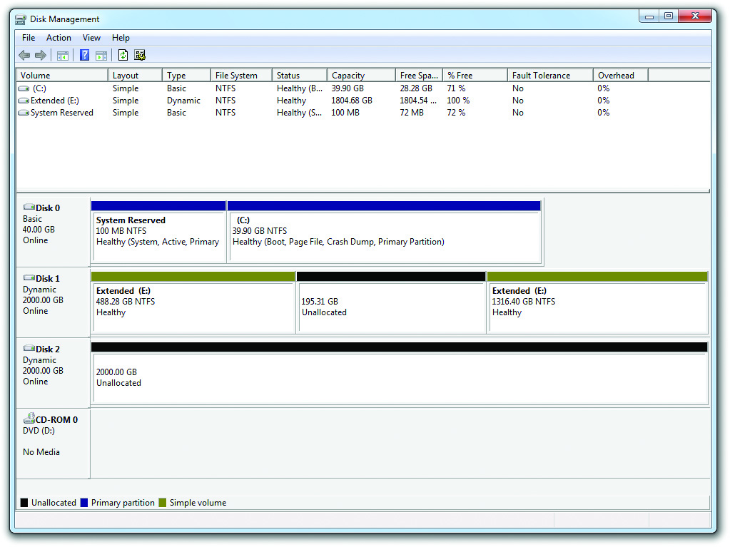
Dynamic Disks
Figure 10.40 Extended volume

Slide 78
Dynamic Disks
Additional types of volumes include:
A striped volume is comprised of two or more dynamic disks that spread out blocks of each file across multiple disks.
All the drives in a group make up a stripe set.
This is a RAID 0 array.
A mirrored volume can be created with Windows 7, and later Professional, Enterprise, and Ultimate editions.
A mirror set features two drives for data redundancy.
Mirrors are RAID 1.

Slide 79
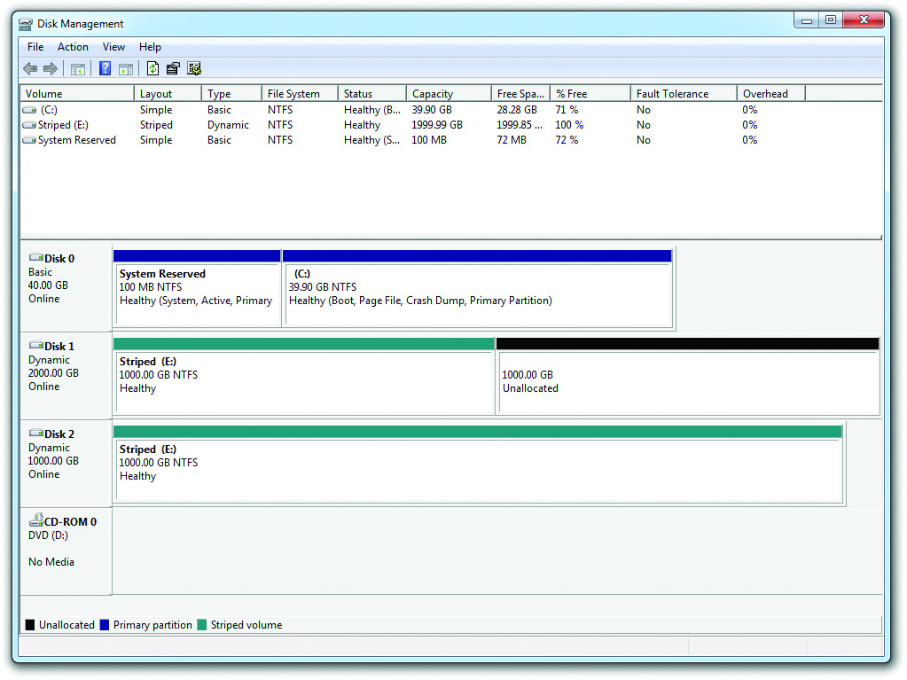
Dynamic Disks
Figure 10.41 Two striped drives

Slide 80
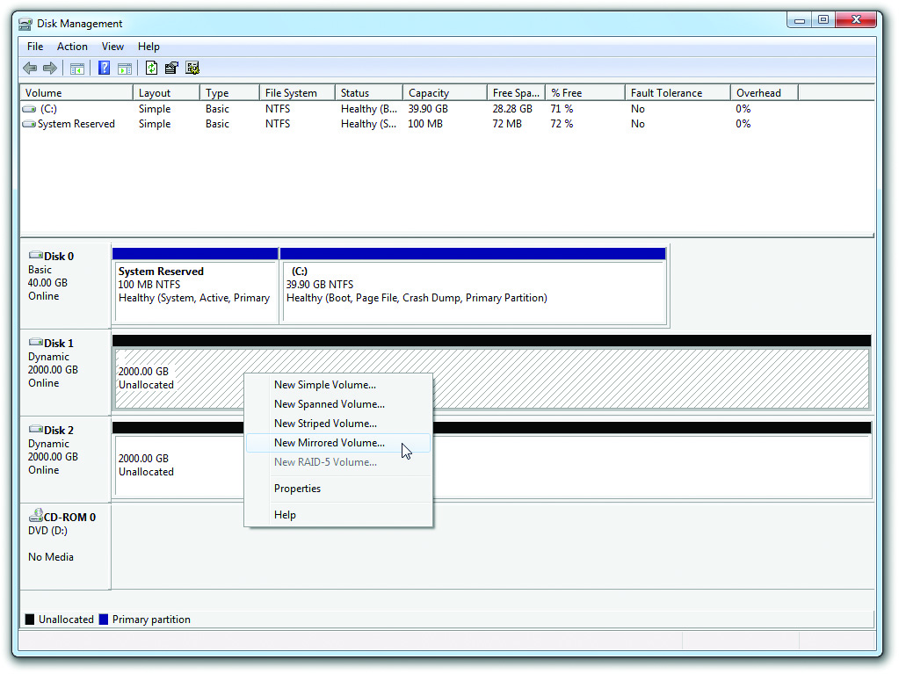
Dynamic Disks
Figure 10.42 Selecting a new mirror

Slide 81
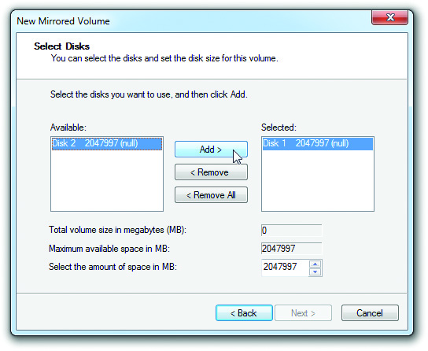
Dynamic Disks
Figure 10.43 Selecting drives for the array

Slide 82
Dynamic Disks
Other levels of RAID
RAID5 storage array uses three or more disks to create a robust solution for storage.
Applies to Professional versions of Windows
However, for those operating systems, you can make the array only on a Windows Server machine that you access remotely across a network.
If RAID 0+1 or RAID 1+0 (RAID 10) are needed, you must use third-party software or implement as hardware RAID.

Slide 83
Partitions as Folders
Partitions and volumes can also be mounted as a folder on another drive.
Known as a mount point
Enables existing folders to store more data than can fit on a single drive or partition/volume

Slide 84
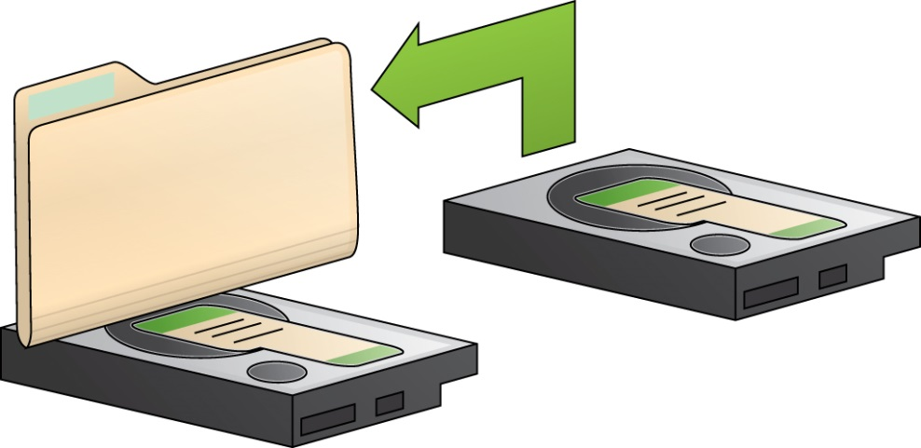
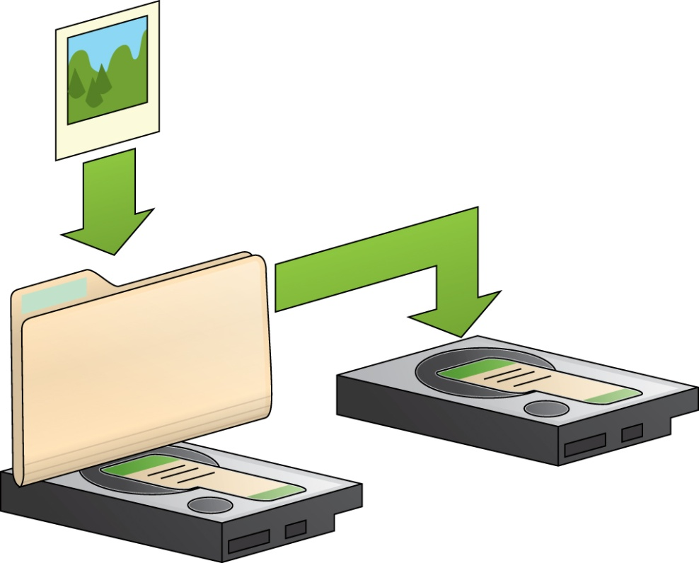
Partitions as Folders
Figure 10.44 Mounting a drive as a folder
Figure 10.45 Adding photos to the mounted folder stores them on the second hard drive.

Slide 85
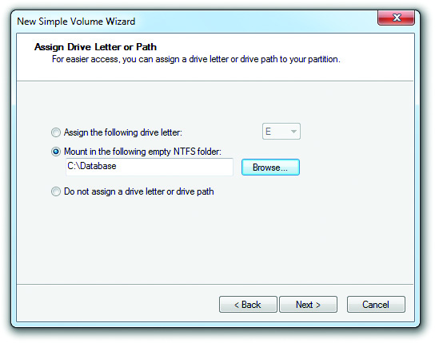
Partitions as Folders
Figure 10.46 Choosing to create a mounted volume

Slide 86
Drive Letters and Paths
Disk Management enables you to modify the drive letter, path, or mount point on currently installed mass storage devices.
Right-click a drive and select Change Drive Letter and Paths.

Slide 87
Formatting a Partition
You can format any Windows partition/volume Format in:
Windows Explorer/File Explorer
Right click on the drive name and choose Format
Disk Management
Preferred formatting tool

Slide 88
Storage Spaces
You can group one or more physical drives of any size into a single storage pool.
Available with Windows 8 and later
Functions like a RAID management tool
Three different types include:
Simple spaces
Mirror spaces
Parity spaces
Thin provisioning allows creating a space with more capacity than physical drives allow.

Slide 89
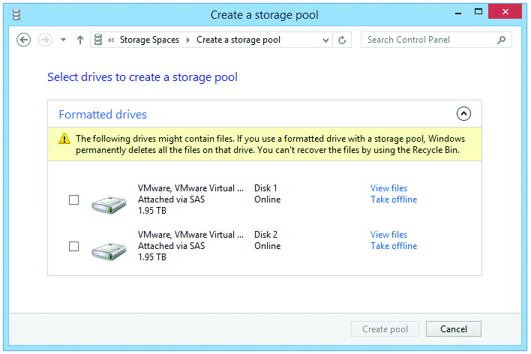
Storage Spaces
Figure 10.49 Formatted drives revealed

Slide 90
Troubleshooting Hard Drives
Maintenance includes two distinct functions:
Checking the disk occasionally for failed clusters
Keeping data organized on the drive so it can be accessed quickly

Slide 91
Troubleshooting Hard Drives
Error checking
Scan for bad clusters
Check for invalid filenames
Can be set to fix errors automatically
Can recover bad sectors
Tools
ScanDisk and chkdsk (Microsoft)
Disk Utility (Mac OS X)
Command-line tool fsck (Linux)

Slide 92
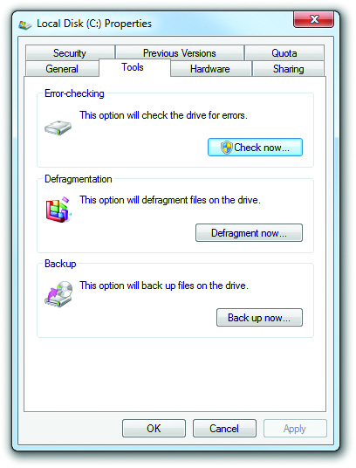
Error Checking
Figure 10.51 The Tools tab in the Properties dialog box
Notes:
92

Slide 93
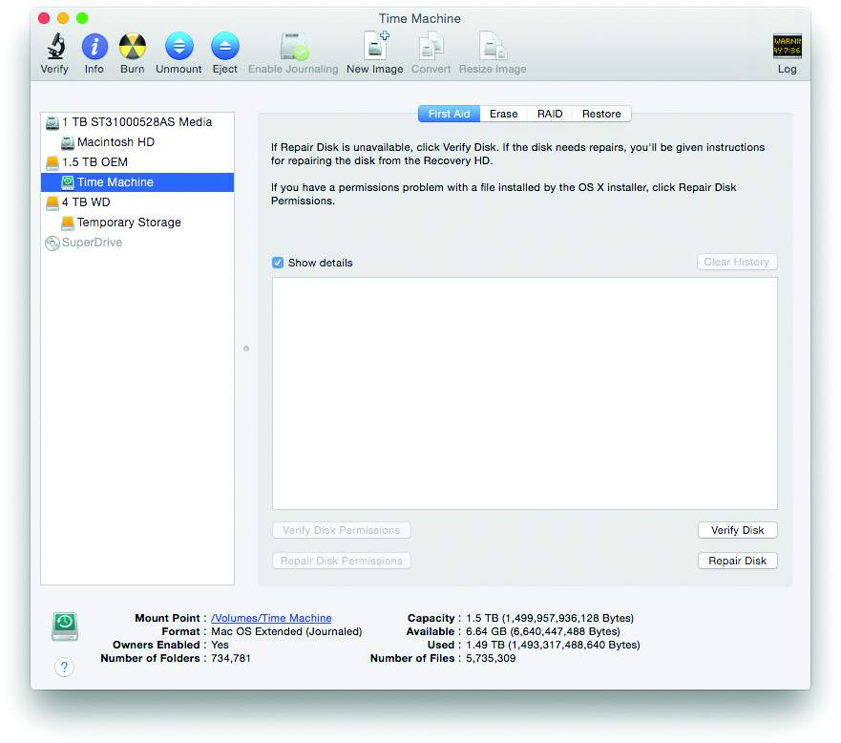
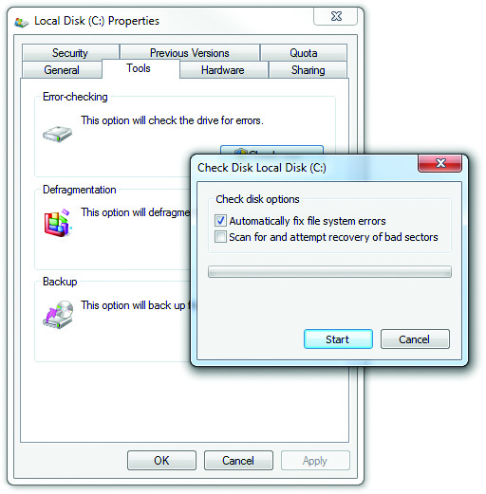
Error Checking
Figure 10.52 Check Disk options
Figure 10.53 Disk Utility options

Slide 94
Defragmentation
It is a good idea to defragment drives as part of monthly maintenance.
Right click a drive and choose Properties.
Select Defragment Now to open Optimize Drives.

Slide 95
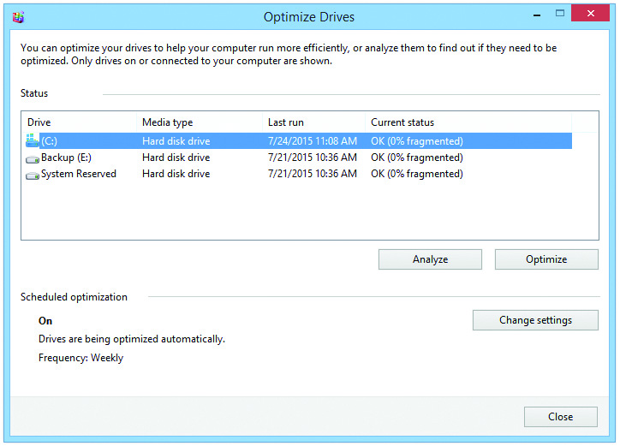
Defragmentation
Figure 10.54 Drives, the defragmenting tool in Windows 8.1

Slide 96
Disk Cleanup
Allows you to purge system of unneeded files
Files in the recycle bin
Temporary Internet files
Downloaded program files
Temporary files
Access to Disk Cleanup:
In Windows Vista and 7, choose:
Start | All Programs | Accessories | System Tools | Disk Cleanup
In Windows 8, type Disk Cleanup in search charm.

Slide 97
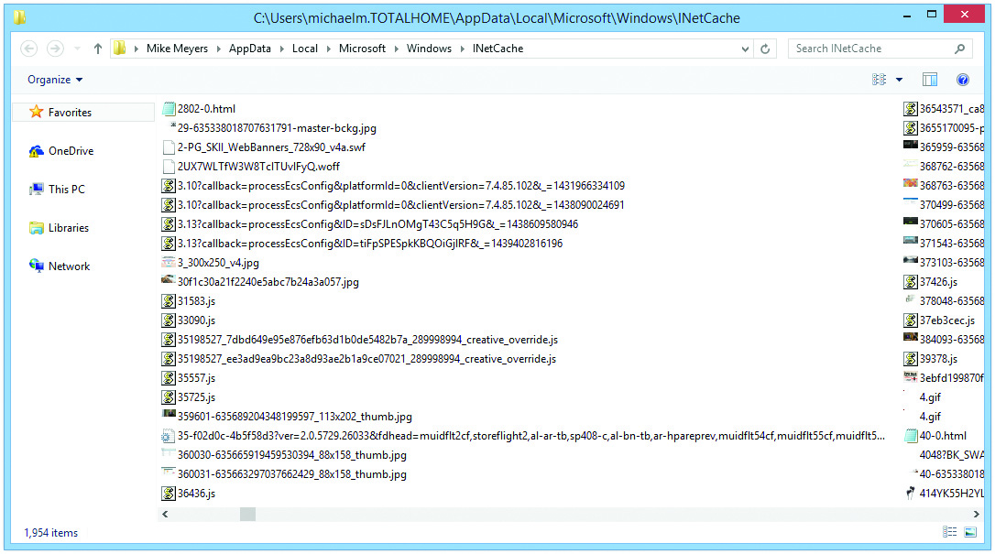
Disk Cleanup
Figure 10.56 Lots of temporary Internet files

Slide 98

Disk Cleanup
Figure 10.57 Disk Cleanup

Slide 99
Troubleshooting Hard Drives
Four broad categories of hard drive failures
Installation errors
Data corruption
Dying hard drives
RAID issues

Slide 100
Troubleshooting Installation
Connectivity
Covered earlier
CMOS
Covered earlier
Partitions
Errors fall into two groups:
Failing to partition at all
Creating the wrong size or type of partition
Solution: open Disk Management and do partitioning correctly

Slide 101
Troubleshooting Installation
Failing to format a drive makes it unable to hold data.
Accessing the drive in Windows results in error messages, such as drive “is not accessible” or “invalid media.”
“Trying to recover lost allocation unit” indicates the drive is dying.
Go through “mental reinstallation” to identify errors that may have occurred during installation.

Slide 102

Troubleshooting Installation
Figure 10.58 The “Trying to recover lost allocation unit” error

Slide 103
Data Corruption
Data corruption may be due to power surges, accidental shutdowns, viruses, and more.
Typical Windows error messages include:
“The following file is missing or corrupt”
“The download location information is damaged”
“Unable to load file”
“…is not a valid Win32 application”
“Bootmgr is missing...”
“Your PC ran into a problem… caused it to restart”
“This app can’t run on your PC”

Slide 104
Data Corruption
Typical core boot errors include:
“Cannot find COMMAND.COM”
“Error loading operating system”
“NTLDR is missing or corrupt”
“An error occurred while attempting to read the boot configuration data”
Try running error checking utility.
Notes:
Hard Drive Warranties
Most hard drives have three-year warranties. Before you throw away a dead drive, check the hard-drive maker’s Web site or call them to see if the drive is still under warranty. Ask for a Return Material Authorization (RMA). You’ll be amazed at how often you get a newer, usually larger, hard drive for free! It never hurts to check!

Slide 105
Data Corruption
A drive may have bad sectors.
The built-in error correction code (ECC) checks the drive for bad sectors.
Disk checkers can fix problems pertaining to corrupted data.
Windows will give you error messages with read/write failures.
Good hard drives don’t fail to read or write, only dying ones.
Notes:
Data Rescue Specialists
If you ever lose a hard drive that contains absolutely critical information, you can turn to a company that specializes in hard drive data recovery. The job will be expensive—prices usually start around US$1000—but when you must recover the data, such companies are your only hope. Do a web search for “data recovery” or check the Yellow Pages for companies in this line of business.

Slide 106

Data Corruption
Figure 10.60 SpinRite at work

Slide 107
Dying Hard Drive
Sounds that indicate a drive about to die:
Continuous high-pitched squeal
Series of clicks, a short pause, and then more clicks
Continuous grinding or rumbling
Back up data and replace the drive.
Notes:
107

Slide 108
Dying Hard Drive
If a drive with the OS dies:
The system locks up.
“No boot device present” message appears on restart.
If it is a second drives, it will stop showing up in Windows Explorer/File Explorer.
Troubleshooting techniques include:
Checking System Setup program for autodetect
Restarting and listening
Checking jumpers (PATA only) and data cable
Notes:
108
Exercise
HDD Diagnosis
While the students are out of the classroom on a break, surreptitiously change the ribbon cable orientations on some drives, reset the jumpers, partially unplug ribbon cables from the motherboards, or change the CMOS values for the drives on others. Allow the students to track down the problems. Having the students work on systems other than those into which they installed the drives will orient them to working on unfamiliar systems—something we all must do.

Slide 109
Troubleshooting RAID
Drive problems in a RAID array are almost identical to those seen on an individual drive.
There are a couple of errors unique to RAID, however, that need their own separate discussion.

Slide 110
Troubleshooting RAID
Drive not recognized
If the configuration firmware doesn’t recognize one of the drives, check to make sure the drives are powered and that they have the proper connections.
Motherboards with onboard RAID may require you to use only certain special RAID connectors.

Slide 111
Troubleshooting RAID
Symptoms when RAID stops working include:
With RAID 0, the effect is a critical stop error, or a Blue Screen of Death (BSoD).
On reboot, the computer will fail to boot or you’ll get a message that the OS can’t be found.
You will normally lose all data.
With all other RAID levels, you will get a notification of the drive failure, and performance will suffer.
You usually won’t lose data, but you must replace the failed drive.

Slide 112
Troubleshooting RAID
“RAID Not Found” errors
These vary greatly depending on make and model of hardware RAID or if you used software RAID.
A properly functioning hardware RAID array will always show up in the configuration utility.
If an existing array stops working and you enter the configuration utility to find the array is gone, you have either dead drives or faulty controllers.
If the array is gone but you can still see the drives, then the controller may have broken the array on its own.

Slide 113
Beyond A+
StorageReview.com is an excellent site.
Third-party partition tools enable you to create, change, and delete partitions without destroying the data.
Avanquest Partition Commander
GParted
Free (open source) license
Linux only
Notes:
113

Slide 114


Beyond A+
Figure 10.61 Partition Commander
Figure 10.62 GParted in action

Slide 115
Questions?

Slide 116
Summary
Explain the partitions available in Windows
Discuss hard drive formatting options
Partition and format hard drives
Maintain and troubleshoot hard drives

Slide 117


